Slide 1
Texture and shape radiomics based machine learning models for prostate cancer risk prediction on MRI
EBME 461
Jaya Krishna N – jxn306
Cathy Tao – cst35

Slide 2
Hypothesis
Prostate cancer (PCa) is the second most common cancer in American men. mpMRI is being used more frequently in PCa detection as Other treatment strategies but the evaluations have been found to significantly vary depending on the radiologist’s experience.
Using Radiomics we extract features computationally from Bi-parametric MRI radiographic images which characterize the lesion and classify them to be whether clinically significant or not by building a machine learning classifier.

Slide 3
Background
Prostate cancer is cancer that occurs in the prostate. The prostate is a small walnut-shaped gland in males that produces the seminal fluid that nourishes and transports sperm.
Prostate cancer is one of the most common types of cancer. Many prostate cancers grow slowly and are confined to the prostate gland, where they may not cause serious harm. However, while some types of prostate cancer grow slowly and may need minimal or even no treatment, other types are aggressive and can spread quickly.
Prostate cancer that's detected early — when it's still confined to the prostate gland — has the best chance for successful treatment.
Symptoms:
Prostate cancer may cause no signs or symptoms in its early stages. Prostate cancer that's more advanced may cause signs and symptoms such as:
Trouble urinating, Decreased force in the stream of urine, Blood in the urine, Blood in the semen, Bone pain ,Losing weight without trying, Erectile dysfunction

Slide 4
Training Data
The region surrounding the PCa lesion, or the peri-tumoral region, may encode useful information that can complement intra-tumoral information to enable better risk stratification. The dataset was collected and curated for research in computer aided diagnosis of prostate MR under supervision of Dr. Huisman, Radboudumc.
Each T2 weighted image has one or more lesions identified and marked by a radiologist.
The size of dataset is 324 lesions of 204 unique cases.

Slide 5
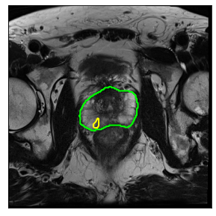
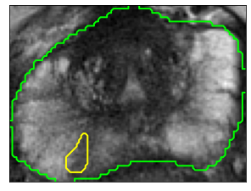
Example of a lesion identified prostate image
Extracted patches based on the bounding box of the mask.
Overlay the prostate mask on the T2W MRI image

Slide 6
Data Preparation and Feature selection
The python package SimpleITK has RadiomicsFeatureExtractor that extracts features that characterize the lesion.
Lot of the extracted features are correlated with each other and we check for correlation and drop the redundant features from the training set.
Using MRMR feature selection technique we select the features which are correlated with our target variable or outcome.
The numerical features are normalized to a scale.
The data is divided into train, validation and test.

